Slide 1
MOVIE
RECOMMENDERS
GROUP 4:
ABDUL
MO
JARI

Slide 2
RECOMMENDER SYSTEMS
POPULARITY RECOMMENDATIONS
ITEM-BASED RECOMMENDATIONS
USER-BASED RECOMMENDATIONS

Slide 3
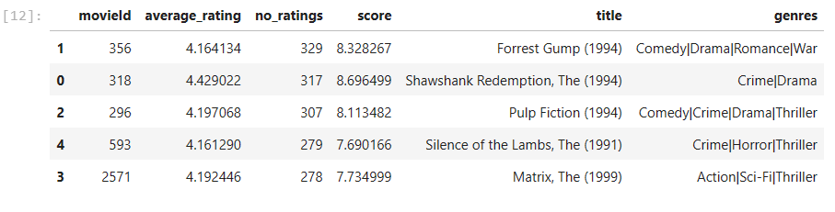
POPULARITY RECOMMENDATIONS
Overall score is a composite indicator of the number of ratings (i.e. popularity) and the average rating (i.e. mean of all user ratings)

Slide 4
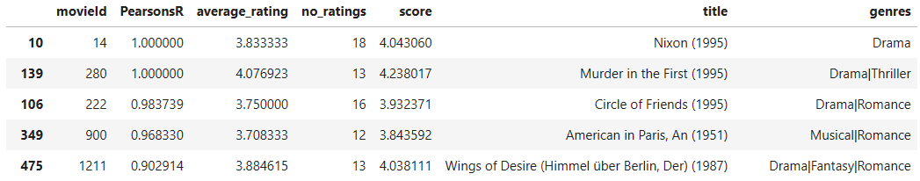
ITEM-BASED RECOMMENDATIONS
Makes recommendations based on similarly rated movies (Pearson’s R).
Recommendations are (rather) stable over time.

Slide 5
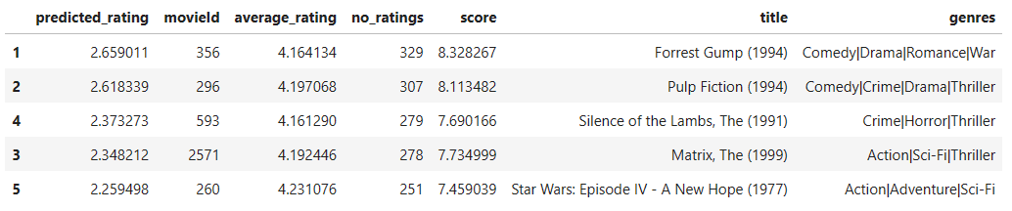
USER-BASED RECOMMENDATIONS
Recommendations based on similar users' (cosine similarity).
Dynamic as user rates additional movies.

Slide 6
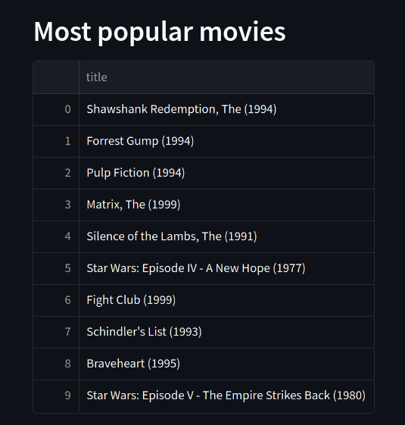
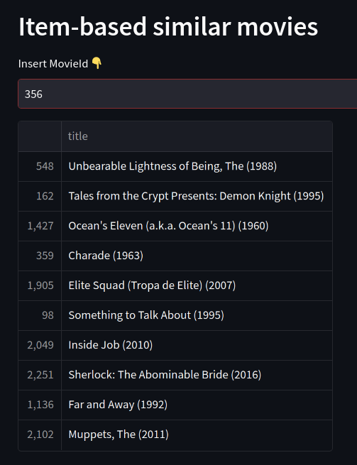
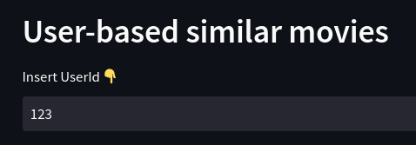
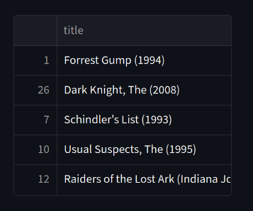
Streamlit: Mojab’s Video Buster

Slide 7
TABLE READ MEETING INFOGRAPHICS
FIRST STEP
1
4
FOURTH STEP
Mercury is the closest planet to the Sun
Jupiter is the biggest planet of them all
TABLE READING PROCESS
SECOND STEP
2
5
FIFTH STEP
Saturn is composed of hydrogen and helium
Venus is the second planet from the Sun
THIRD STEP
3
6
SIXTH STEP
Neptune is very far away from Earth
Mars is actually a very cold place

Slide 8
TABLE READ MEETING INFOGRAPHICS
FILMING CHORES FOR THE DAY
TASK 1
TASK 2
TASK 3
TASK 4
TASK 5

Slide 9
TABLE READ MEETING INFOGRAPHICS
01
DAY ISSUE
03
DAY ISSUE
05
DAY ISSUE
Jupiter is the biggest planet of them all
Venus is the second planet from the Sun
Saturn is composed of hydrogen mainly
02
DAY ISSUE
04
DAY ISSUE
06
DAY ISSUE
Neptune is far away from Earth
Mars is actually a very cold place
Mercury is the closest planet to the Sun

